Slide 1
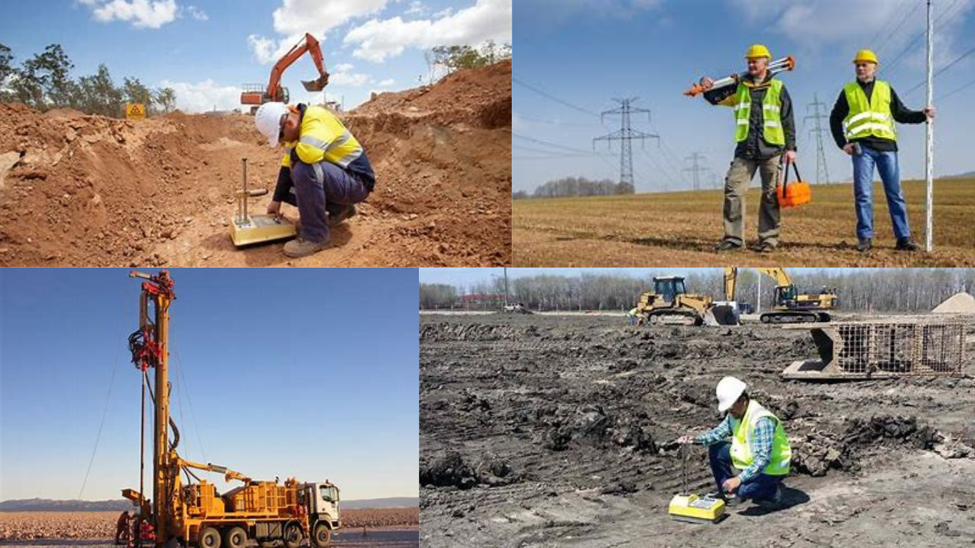

JAABIA Launches Innovative Geotechnical and Hydrogeological Services
Revolutionizing Geotechnical and Hydrogeological Solutions
Presented
By
Umar Adekola

Slide 2
INTRODUCTION
Overview of JAABIA
Introduction to the new comprehensive service offerings
Significance of this launch in the current market landscape

Slide 3
PRODUCT FEATURES
Service Features:
Geotechnical Engineering Consultancy: Expert advice on construction projects, foundation design, and slope stability analysis.
Hydrogeological Consultancy: Groundwater resources assessment, aquifer characterization, and contamination remediation.
Groundwater Geophysical Surveys: Advanced geophysical techniques for subsurface mapping.
Borehole Drilling: Professional services for water wells and geotechnical investigations.
Pump Installation and Maintenance: Comprehensive pump services for water supply and irrigation systems.
Water Treatment: Quality checks for physicochemical and potentially toxic elements.

Slide 4
PRODUCT BENEFITS
Service Benefits:
Innovative Solutions: Cutting-edge technology and methodologies.
Reliability: High-quality, accurate, and dependable services.
Expertise: Professional and experienced team of engineers and geologists.
Comprehensive Support: End-to-end solutions from consultation to maintenance.

Slide 5
MARKET ANALYSIS
Market Analysis:
Current Landscape: Overview of the geotechnical and hydrogeological services market in Nigeria.
Target Market Segments: Construction companies, government agencies, academic institutions, and rural communities.
Competitive Analysis: Positioning JAABIA against key competitors.
Market Opportunities: Growing demand for reliable water resource management and infrastructure development.

Slide 6
PROMOTIONAL STRATEGIES
Promotional Strategies:
Digital Marketing: Website optimization, social media campaigns, SEO, and email newsletters.
Content Marketing: Case studies, blog posts, video tutorials, and whitepapers.
Traditional Marketing: Print advertisements, participation in industry conferences, and local community events.
Partnerships: Collaborations with academic institutions, government agencies, and industry influencers.

Slide 7
PRICING STRATEGY
Pricing Strategy:
Competitive Pricing: Fair and competitive pricing model to attract and retain clients.
Value Proposition: Highlighting the value and benefits over competitors.
Discounts and Offers: Introductory discounts and package deals for early clients.

Slide 8
SALES & DISTRIBUTION PLAN
Sales & Distribution Plan:
Sales Channels: Direct sales, online inquiries, and partnerships with local distributors.
Distribution Networks: Efficient logistics and support systems to reach clients across Nigeria.
Sales Targets: Quarterly and yearly sales goals to measure success.

Slide 9
LAUNCH TIMELINE
Launch Timeline:
Phase 1: Product development and testing (Months 1-3)
Phase 2: Pre-launch preparations and marketing (Months 4-5)
Phase 3: Official launch event and media coverage (Month 6)
Phase 4: Post-launch follow-up and client feedback (Months 7-8)

Slide 10
CONCLUSION & Q&A
Conclusion & Q&A:
Summary of key points
Vision for JAABIA’s future and impact on the industry
Questions and discussion

